Slide 1
Identifying best neighborhoods in NYC for opening Italian restaurant

Slide 2
Identifying best neighborhoods using location data
We will first look at the number of existing Italian restaurants in each Neighborhood.
Neighborhoods that have least number of Italian restaurants will be most promising for opening one.

Slide 3
Gathering and preparing data
Using FOURSQUARE API, we have gathered coordinates of NYC neighborhoods and number of Italian restaurants in each neighborhood.
These data are cleaned and used to produced charts and interactive maps which will help us make better decision.

Slide 4
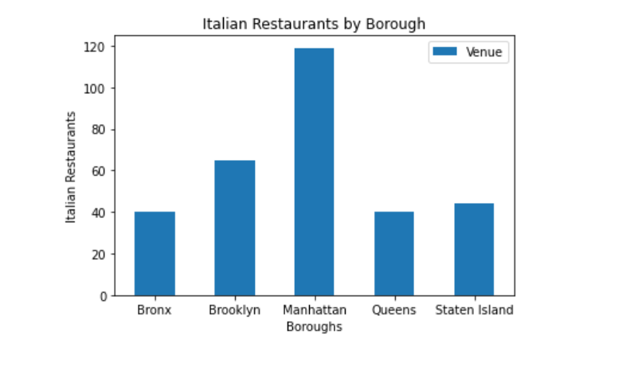
Existing Italian restaurants per Borough

Slide 5
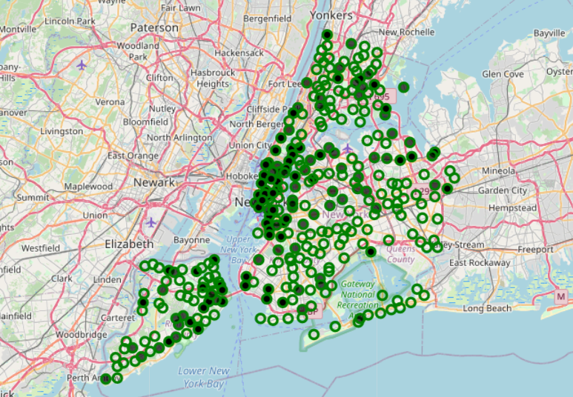
Italian restaurants per Neighborhood (Interactive map)

Slide 6
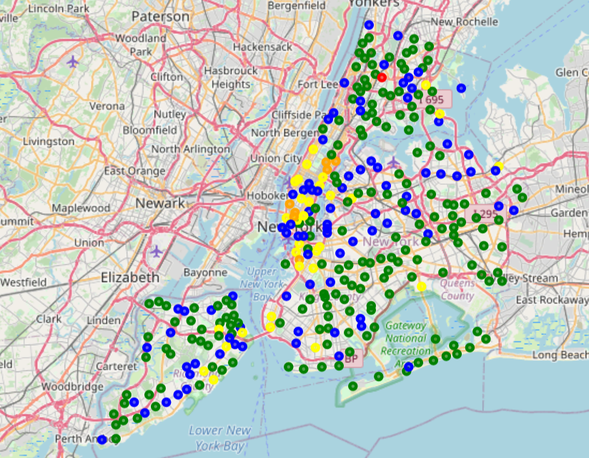
Neighborhoods classified by K-means (clustered) based on number of existing Italian restaurants (Interactive map)

Slide 7
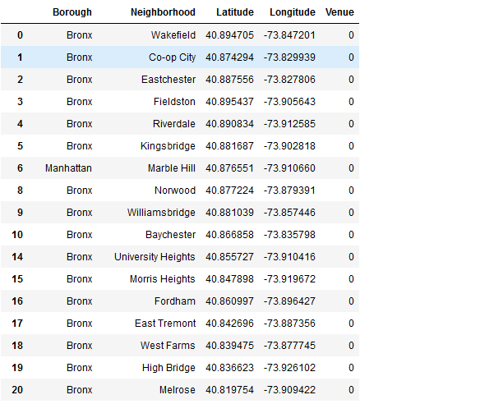
List of neighborhoods (full list in Github file) that does not have Italian restaurant.

Slide 8
Conclusion
Based on the data we gathered, we have identified the neighborhoods the have no Italian restaurants.
These will be the most promising neighborhoods to open on.

